Slide 1
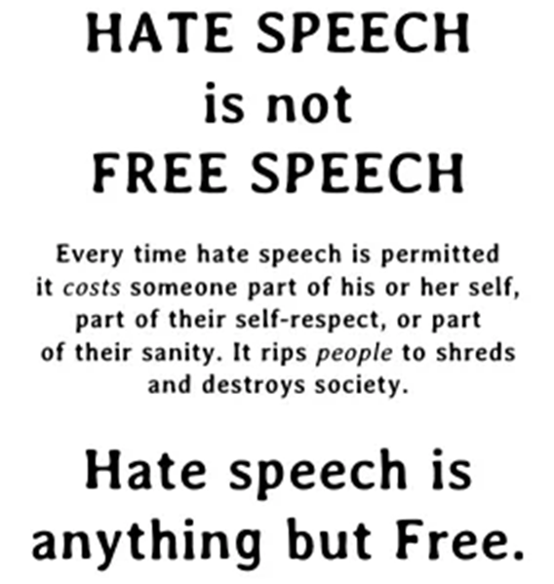
Problem & Motivation
Notes:
Hate speech on social media has become a major concern in recent years.
It refers to any form of communication that attacks or dehumanizes individuals or groups based on their race, religion, ethnicity, sexual orientation, or other personal characteristics.
This type of speech can create a toxic and hostile environment on social media platforms, leading to increased harassment, bullying, and discrimination.
It also has the potential to spread misinformation and incite violence. Social media companies have implemented various measures to address the issue, such as removing hate speech content, banning accounts that repeatedly engage in hate speech, and working with experts to better understand the nature of the problem and how to tackle it.
However, the issue remains complex and ongoing, as the sheer volume of content on these platforms and the difficulty of defining and detecting hate speech makes it challenging to effectively address.
One of the difficulties in dealing with hate speech on social media and other platforms is determining what defines hate speech. The border between right to freedom of expression and hate speech is frequently blurred, and defining where that line is may be challenging. Some may claim that some types of hate speech should be protected under the free speech label, while others feel that such speech should be tightly forbidden.

Slide 2







Solutions out there
Notes:
Social media platforms have different policies and techniques for handling hate speech on their platforms.
Social media giants like facebook and twitter use combination of human moderators and AI technology to detect and remove hate speech. They also provides a reporting mechanism for users to flag content they believe to be hate speech.
however , platforms like blogger, medium and weebly only have reporting mechanisms and use of human moderators.

Slide 3
Model development process
Data Preprocessing
Natural Language Processing
Model Selection
SVM, Random Forest, KNN, Logistic Regression, Naive Bayes,
Model Evaluation
Accuracy, Recall, Precision, F1-score
Selection of Input Features
TF-IDF, Polarity Scores
Model Training
Class balancing, Parameter tuning

Slide 4
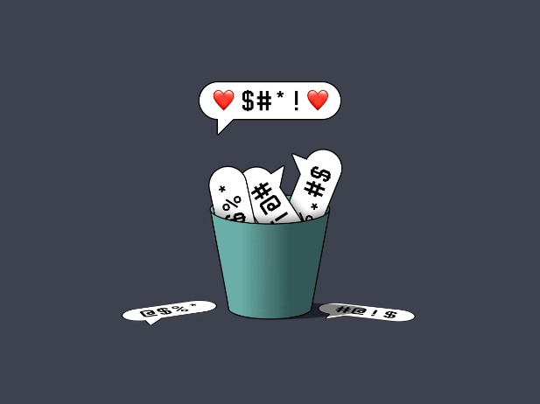

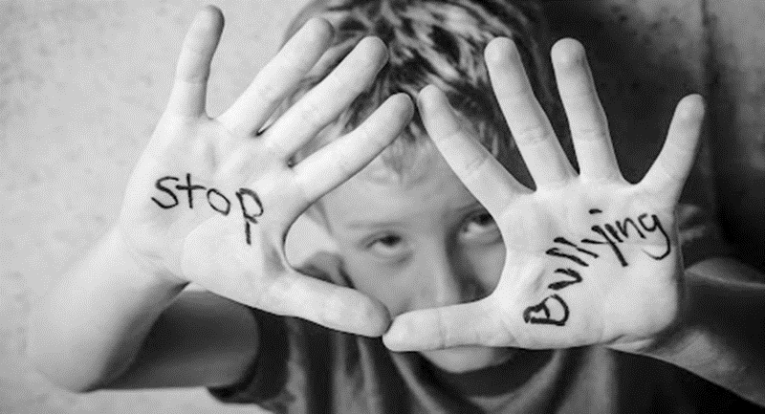
What to Achieve?
Model : For a given text input, our application should be able to classify the text as a hate message, an offensive message or clean
Application: The Model should be deployed to the web application

Slide 5
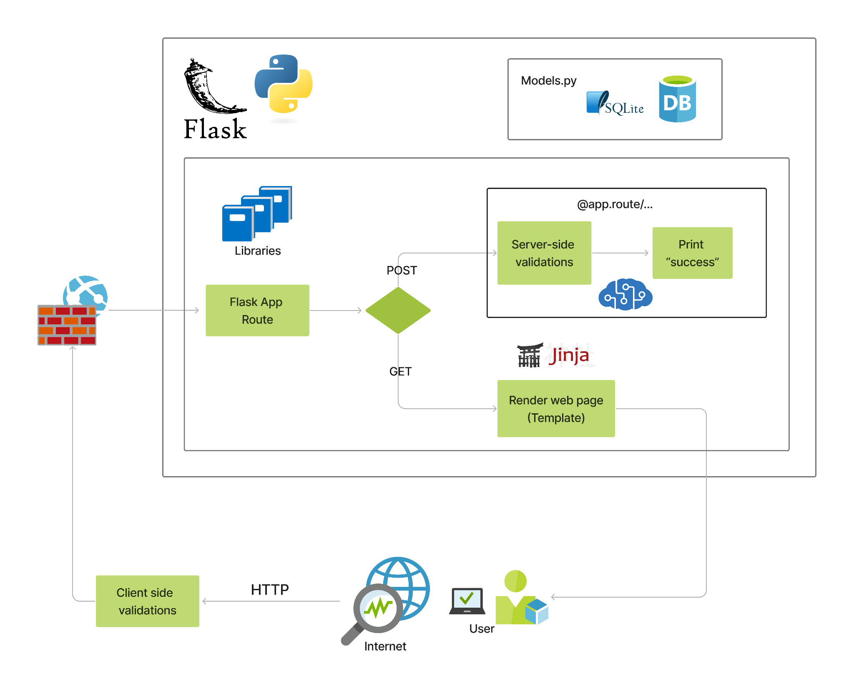
What’s Happening Inside the web Application?

Slide 6
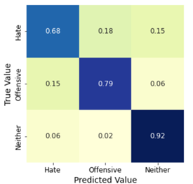
Results
Selecting A Final model
Random Forest | Original | Under sampled | Oversampled
Accuracy | 0.8977 | 0.8059 | 0.8882
Recall Scores
Hate speech | 13% | 68% | 37%
Offensive | 97% | 79% | 95%
neither | 85% | 92% | 80%

Slide 7
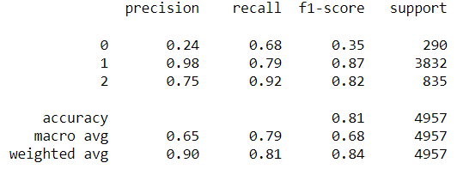
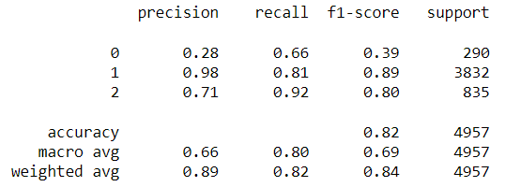
Final Model performance
Before Optimization
After Optimization

Slide 8
Test Samples from the App
input | Expected prediction | Actual prediction
“All ****** are a threat to this world” | Hate speech | Hate speech
“aggressive religious groups should be punished. we are not doing enough to get rid of those filthy animals” | Hate speech | Hate speech
“whoever wrote this is a waste of space” | Offensive language | Hate speech
“you are too dumb to apply for that company” | Offensive language | Offensive language
“I wish I could bomb the whole parliament with all the 225 in it” | Offensive language | Offensive language
“she looks like monkey who had a plastic surgery” | Offensive (insulting) | clean

Slide 9
To Conclude
Limitations
Detecting hate speech in multimedia and multi languages.
Contextual data.
Laws and Regulations of different countries have not been considered.
Real time detection can be problematic for the performance as the application grows specially, when the number of content posted increases.
Future work
Multiple language compatibility
Multiple media compatibility
Deploy as an API

